Slide 1


OMG Systems Modeling Language (OMG SysML™)
Tutorial
September, 2009
Sanford Friedenthal Alan Moore
Rick Steiner
(emails included in references at end)
Copyright © 2006-2009 by Object Management Group.
Published and used by INCOSE and affiliated societies with permission.

Slide 2

OMG SysML™ Specification
Specification status
  Adopted by OMG in May ’06
  Available Specification v1.0 in Sept ’07
  Available Specification v1.1 in Nov ‘08
  Revision task force for v1.2 in process
Multiple vendor implementations available
This tutorial is based on the OMG SysML available specification (formal/2007-09-01)
This tutorial, the specifications, papers, and vendor info can be found on the OMG SysML Website at http://www.omgsysml.org/
Refer to “A Practical Guide to SysML” by Friedenthal, Moore, and Steiner for language details and reference
2

Slide 3
Objectives & Intended Audience
At the end of this tutorial, you should have an awareness of:
Motivation of model-based systems engineering approach
SysML diagrams and language concepts
How to apply SysML as part of a model based SE process
Basic considerations for transitioning to SysML
This course is not intended to make you a systems modeler!
You must use the language.
Intended Audience:
Practicing Systems Engineers interested in system modeling
Software Engineers who want to better understand how to integrate software and system models
Familiarity with UML is not required, but it helps
•
2

Slide 4
Topics
Motivation & Background
Diagram Overview and Language Concepts
SysML Modeling as Part of SE Process
  Structured Analysis – Distiller Example
  OOSEM – Enhanced Security System Example
SysML in a Standards Framework
Transitioning to SysML
Summary
Class Exercise
2

Slide 5
Motivation & Background

Slide 6



















SE Practices for Describing Systems
Past
Future
Specifications
Interface requirements
System design
Analysis & Trade-off
Test plans
Moving from Document centric to Model centric

Slide 7





System Modeling
Requirements
Start
Shift
Accelerate
Brake
Control Input
Power Equations
Vehicle Dynamics
Mass
Pr
operties
odel
^{M} Structur
al
M
odel
Safe M
ty
odel
Cost Model
Engine |  | Transmission |  | Transaxle
Integrated System Model Must Address Multiple Aspects of a System

Slide 8
Model Based Systems Engineering Benefits
Shared understanding of system requirements and design
  Validation of requirements
  Common basis for analysis and design
  Facilitates identification of risks
Assists in managing complex system development
  Separation of concerns via multiple views of integrated model
  Supports traceability through hierarchical system models
  Facilitates impact analysis of requirements and design changes
  Supports incremental development & evolutionary acquisition
Improved design quality
  Reduced errors and ambiguity
  More complete representation
Supports early and on-going verification & validation to reduce risk
Provides value through life cycle (e.g., training)
Enhances knowledge capture

Slide 9
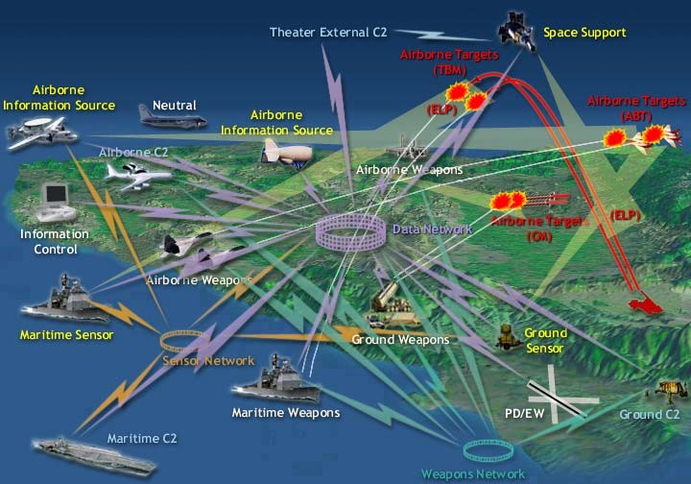

System-of-Systems
Interactions
Boundaries
Modeling Needed to Manage System Complexity

Slide 10
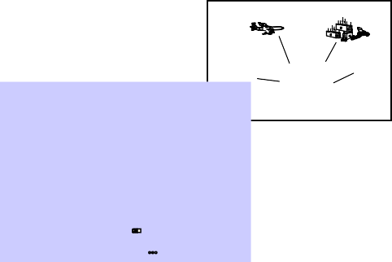


Modeling at Multiple Levels of the System
MCE (CRC)
AWACS
MCE (CRC)
MCE (CRC)
AMDPCS
LINK 16
FAAD C3I
LINK 16
AWACS
E-2C
F/A-18
LINK 16
LINK 16
Patriot ICC
RIVET JOINT
MCE
F-15C
SIAP
Operator Interf
Hardware
Power
Data Processi Terminal Hardware
Software
PLGR (GPS)
Operator Interf Hardware
Data Processi Terminal Hardware
ace
ABMOC Subsystem
_{Power} Voice Comm
Operational Models
ACDS (CVN)
Power Generation and Distribution
Hardware includes MSE
ng
Power JTIDS
Terminal
^{Power} TCIM
CG
TAOM
DDG-51 AEGIS Destroyer
EPLRS or SINGARS
Terminal
Power
Force Level Control System
Patriot ICC
Power Voice & TADIL-B Data
Power
ace
Power
A2C2 Subsystem _{Power}
Power Generation and Distribution
Voice Comm Hardware includes MSE
CEC Inform ation Exchange Require m ents - Class ifie d SECRET when filled in
ng
Power
1
Rationale/UJTL Num ber Event/Acti
OP 5.1.1 Com m Op Info ^{Provide S}
Engage m e
OP 5.1.1 Com m Op Info ^{Provide S}
Engage m e
OP 5.1.1 Com m Op Info ^{Provide S}
Engage m e
OP 5.1.1 Com m Op Info ^{Provide S}
Engage m e
OP 5.1.1 Com m Op Info ^{Provide S}
Engage m e
2 3 4 5 6 7 8 9 10 11
on Inform ation Characte rization ^{Se nding Re ceiving} Critical Form at Class Late ncy: SA/Eng Me ss age Rem ark s
Node Node Support Error Rate
A/Support Radar m e asurem e nts to REF: CEC A-spec
nts support data fus ion com posite Host CEP Ye s Binary IAW IDD Se cret xx s ecs/xx se cs xx % Table 3-3 and track ing Hos t re qm ts
FAAD C3I
Voice & TADIL-B Data
Power
TCIM
AMDPCS
Software
JTIDS
Terminal
A/Support IFF m e as urem e nts to support
nts data fus ion and com pos ite Host CEP Ye s Binary IAW IDD Se cret xx s ecs/xx se cs xx %
EPLRS or SINGARS
track ing
Power
Terminal
Power
A/Support IFF inte rrogation re que sts to Res pond w he n
nts support data fus ion and Host CEP Ye s Binary IAW IDD Se cret xx s ecs/xx se cs xx % requested com posite tracking
A/Support ID Change s to s upport data Host CEP Ye s Binary IAW IDD Se cret xx s ecs/xx se cs xx % nts fusion and com posite track ing
A/Support Navigation data to support data Host CEP Ye s Binary IAW IDD Se cret xx s ecs/xx se cs xx % ^{REF:CEC SRS and} nts fusion and com posite track ing Host Nav. spec
Force Level Control System
PLGR (GPS)
Power
Provide SA/Support ^{Engagem e nt Support Reque sts}
^{OP 5.1.1 Com m Op Info} Engage m e nts to support data fus ion and Host CEP Ye s Binary IAW IDD Se cret xx s ecs/xx se cs xx % AEGIS only com posite tracking
Provide SA/Support ^{Track num ber m anagem e nt to} Changes se nt
^{OP 5.1.1 Com m Op Info} Engage m e nts support data fus ion and Host-CEP CEP-Host Ye s Binary IAW IDD Se cret xx s ecs/xx se cs xx % immediately com posite tracking
Provide SA/Support ^{Com pos ite Track State Update} REF: CEC IDDs for
^{OP 5.1.1 Com m Op Info} Engage m e nts to support data fus ion and CEP Host Ye s Binary IAW IDD Se cret xx s ecs/xx se cs xx % each host com posite tracking
Provide SA/Support Ass ociate d M e asurem e nt REF: CEC A-spec
^{OP 5.1.1 Com m Op Info} Engage m e nts Re ports to support data fus ion CEP Host Ye s Binary IAW IDD Se cret xx s ecs/xx se cs xx % Table 3-3. SPY and com posite track ing
only
Provide SA/Support ^{IFF As signm e nts to support} Whe n ass igned
^{OP 5.1.1 Com m Op Info} Engage m e nts data fus ion and com pos ite CEP Host Ye s Binary IAW IDD Se cret xx s ecs/xx se cs xx % or change d
Network Plan
track ing
Provide SA/Support ^{ID recommendations to} Whe n ass igned
Network Network Track Data ^{Receive Network Track Data}
CID Criteria
^{OP 5.1.1 Com m Op Info} Engage m e nts support data fus ion and CEP Host Ye s Binary IAW IDD Se cret xx s ecs/xx se cs xx % or change d com posite tracking
Provide SA/Support Se ns or cue s to s upport data ^{REF: CEC A-spec}
^{OP 5.1.1 Com m Op Info} Engage m e nts fusion and com posite track ing CEP Host Ye s Binary IAW IDD Se cret xx s ecs/xx se cs xx % Table 3-3. SPY
only
Track File
11
^{Correlate Track} Correlated Track
Files
12
Manage BMDS _{BMDS Track}
JDN
Correlation S/W
Track File Data
ack File
HIC
13
ule
k s
Network Track MSG
Network Interface S/W
Module
NetworkNetwork InterfaceInterface TrackTrack ManagementManagement ModuleModule CorrelationCorrelation Mod
ModuleModule
Attempt to ^{Request}
Track Data Correlate with ^{Track Data Possible} BMDS Track ^{BMDS Trac}
File Matche
TrTr
Track F
Track Data ^{Se}
Fil
ile Request
System Models
HIC
nd Track
Track Mangement S/W Module
e Data
BMDS Track Data Correlate Tracks BMDS Track Data
Verify CID, Correlation, and Assoicated Track Data
Correlation Results
Update Track
Session Activated
Correlation no Possible
^{yes} File Data
/ initialize
Create New BMDS Track
Correlation Complete ( C
Results ) [ set not null ] / Se
Correlating Tracks
On entry / match state vector Do / corr state vectors
Do / corr LPE Do / corr PIP Do / corr RCS Do / corr CID
orrelation
nd Result
s
On exit / corr BMDS Track #
s
Idle
Network Track File Received ( File Data ) [ number tracks
BMDS Track Display
Monitor Correlation Process
> 0 ] / Input Network Track
Receiving Network Track File
BMDS Track Data
Data
^{Track MSG Data} Send BMDS Track Data to
JDN
Prepared Track MSG
On entry / receive file data Do / store track data
On exit / request matching data
<
<
<
<
<
<
TITLE>System Design<TITLE>
corr fail / is new BMDS Track
META http-equiv="REFRESH"
corr success / is corr BMDS Track
BMDS Track File Request Sent ( Request
!--CSSDATA:966533483-->
BMDS Track File Data Received ( File Data ) / Correlate Tracks
Receiving BMDS Track File Data
) / Pull BMDS Track Files
SCRIPT src="/virtual/2000/code
On entry / receive file data Do / store track data
LINK rel="stylesheet" href="/
SCRIPT language="javascript"
JDN
manages
1..*
Track Mangement Module
/current tracks
/associated track data
/CID data
assign CID () recommend CID () retrieve track file data () display track file data ()
1..*
uses 1..*
HIC
communicates with
1..*
ABMOC Subsystem
1
0..*
interface for
¹ 1
Operator Interface Hardware
 | Power
Power Generation and Distribution
Power
Voice Comm Hardware includes MSE
1
<<entity>> Track File
<<interface>>
Network Interface Module
Correlation Module
Data Processing Terminal Hardware
Power JTIDS
Terminal
received from
Track Number CID
/State Vector
/Date-Time
0..*
buffer capacity
/msg data
algorithm
/tracks to be correlated correlation data decorrelation data
^{Power} TCIM
send track data ()
receive msg () parse msg () route msg data () build msg () send msg ()
correlate tracks () decorrelate tracks () retrieve track data () send track data ()
Software
EPLRS or SINGARS
Terminal
Power Force Level
Control System
Component Models
0..*
correlates
1
PLGR (GPS)
Power Voice & TADIL-B Data
<<entity>>
<<entity>>
Network Track
BMDS Track
^{Customer} Software License
^{Primary Key} Primary Key is subj
^{Customer_ID [PK1] owns} Serial_Number [PK1]
^{Non-Key Attributes} Non-Key Attributes
^{Customer_Name} Technical_Contact Purchase_Contact
Customer_Address
ect to ^{Client Call}
A2C2 Subsystem
Power
^{owning element} <<derived>> /associated data
^{Received Date-Time} traces to /history local track number
Primary Key
PK1] [FK]
Power
receive () store () update () send ()
create ()
Serial_Number [
Operator Interface
Hardware
Data Processing Terminal Hardware
Software
Power Force Level
Control System
Power
Power
Power Generation and Distribution
Power
Voice Comm Hardware includes MSE
update ()
destroy ()
retrieve ()
consists of
creates
Voice & TADIL-B Data
Power
TCIM
Software Release Primary Key Version_Number [PK1]
Tech Support System Entry
JTIDS
Terminal
Primary Key
TSS_Entry_Number [PK1]
EPLRS or SINGARS
Terminal
Non-Key Attributes
Windows_Version
Location Primary Key
Status
is a Primary Key
TSS_Description
currently has
PLGR (GPS)
Power
Status [PK1] [FK]
Status [PK1]

Slide 11



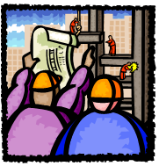









Stakeholders Involved in System Acquisition
Developers/ Integrators
Customers
Project Managers
Vendors
Regulators
Testers
Modeling Needed to Improve Communications

Slide 12

What is SysML?
A graphical modelling language in response to the UML for Systems Engineering RFP developed by the OMG, INCOSE, and AP233
– a UML Profile that represents a subset of UML 2 with extensions
Supports the specification, analysis, design, verification, and validation of systems that include hardware, software, data, personnel, procedures, and facilities
Supports model and data interchange via XML Metadata Interchange (XMI®) and the evolving AP233 standard (in-process)
SysML is Critical Enabler for Model Driven SE

Slide 13
What is SysML (cont.)
Is a visual modeling language that provides
  Semantics = meaning
  Notation = representation of meaning
Is not a methodology or a tool
  SysML is methodology and tool independent

Slide 14
Diagram Overview & Language Concepts

Slide 15
Relationship Between SysML and UML
UML 2
SysML
SysML extensions to UML (SysML Profile)
UML
reused by SysML (UML4SysML)
UML
not required by SysML (UML - UML4SysML)
SysML Extensions
-Blocks
-Item flows
-Value properties
-Allocations
-Requirements
-Parametrics
-Continuous flows
-…
4/15/2008
Copyright © 2006-2008 by Object Management Group.
15

Slide 16
SysML Diagram Taxonomy
SysML Diagram
Behavior Diagram |  |  | Requirement Diagram |  |  | Structure Diagram
Block Definition Diagram |  |  | Internal Block Diagram |  |  | Package Diagram
Activity Diagram
Sequence Diagram
State Machine Diagram
Use Case Diagram
Same as UML 2
Parametric Diagram
Modified from UML 2
New diagram type
4/15/2008
Copyright © 2006-2008 by Object Management Group.
16

Slide 17
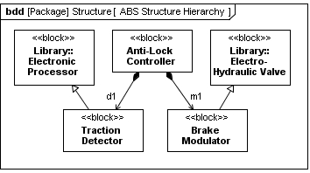
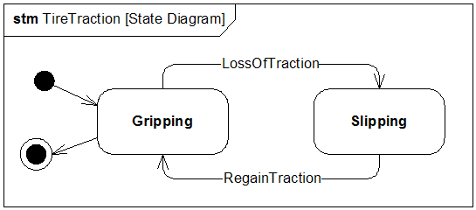
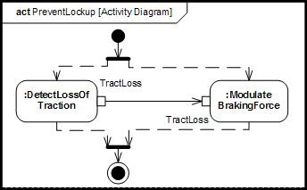
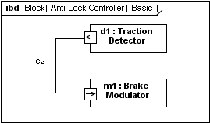
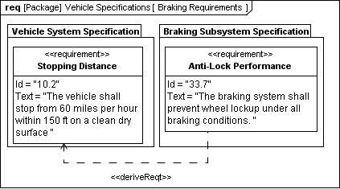
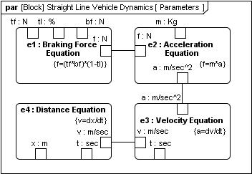
4 Pillars of SysML – ABS Example
1. Structure
2. Behavior
interaction
state machine
sd ABS_ActivationSequence [Sequence Diagram]
d1:Traction Det
m1:Brake
ector Modulator
detTrkLos() sendSignal()
modBrkFrc(traction_signal:boolean)
modBrkFrc()
sendAck()
activity/ function
definition
use
3. Requirements
4. Parametrics
17
4/15/2008 Copyright © 2006-2008 by Object Management Group.

Slide 18

SysML Diagram Frames
Each SysML diagram represents a model element
Each SysML Diagram must have a Diagram Frame
Diagram context is indicated in the header:
  Diagram kind (act, bdd, ibd, sd, etc.)
  Model element type (package, block, activity, etc.)
  Model element name
  User defined diagram name or view name
A separate diagram description block is used to indicate if the
diagram is complete, or has elements elided
Diagram Description
Version: Description: Completion status: Reference:
(User-defined fields)
Header
«diagram usage»
diagramKind [modelElementType] modelElementName [diagramName]
Contents
4/15/2008
Copyright © 2006-2008 by Object Management Group.

Slide 19
Structural Diagrams
SysML Diagram
Behavior Diagram |  |  | Requirement Diagram |  |  | Structure Diagram
Block Definition Diagram |  |  | Internal Block Diagram |  |  | Package Diagram
Activity Diagram
Sequence Diagram
State Machine Diagram
Use Case Diagram
Same as UML 2
Parametric Diagram
Modified from UML 2
New diagram type
4/15/2008
Copyright © 2006-2008 by Object Management Group.

Slide 20
Package Diagram
Package diagram is used to organize the model
  Groups model elements into a name space
  Often represented in tool browser
  Supports model configuration management (check-in/out)
Model can be organized in multiple ways
  By System hierarchy (e.g., enterprise, system, component)
  By diagram kine (e.g., requirements, use cases, behavior)
  Use viewpoints to augment model organization
Import relationship reduces need for fully qualified name (package1::class1)
4/15/2008
Copyright © 2006-2008 by Object Management Group.

Slide 21
Package Diagram Organizing the Model
pkg SampleModel [by diagram type]
pkg SampleModel [by level]
pkg SampleModel [by IPT]
Use Cases
Enterprise
Architecture Team
Requirements
System
Requirements Team
Behavior
Logical Design
IPT A
Structure
Physical Design
IPT B
EngrAnalysis
Verification
IPT C
By Diagram Type
By Hierarchy
By IPT
4/15/2008
Copyright © 2006-2008 by Object Management Group.

Slide 22
Package Diagram - Views
pkg SampleModel[by level]
Viewpoint represents the stakeholder perspective
View conforms to a particular viewpoint
  Imports model elements from multiple packages
  Can represent a model query based on query criteria
View and Viewpoint consistent with IEEE 1471 definitions
Enterprise
«import»
System
«import»
«view» EngrAnalysis
«import»
Logical Design
«conforms»
«import»
EngrAnalysisViewpoint
Physical Design
«viewpoint» stakeholders=”…” purpose=”…” constructionRules= ”…” concerns=”…” languages=”…”
Verification
4/15/2008
Copyright © 2006-2008 by Object Management Group.

Slide 23
Blocks are Basic Structural Elements
Provides a unifying concept to describe the structure of an element or system
System
Hardware
Software
Data
Procedure
Facility
Person
«block» BrakeModulator
allocatedFrom
«activity»Modulate BrakingForce
Compartment Label
values
DutyCycle: Percentage
Multiple standard compartments can describe the block characteristics
  Properties (parts, references, values, ports)
  Operations
  Constraints
  Allocations from/to other model elements (e.g. activities)
  Requirements the block satisfies
  User defined compartments
4/15/2008
Copyright © 2006-2008 by Object Management Group.

Slide 24
Property Types
Property is a structural feature of a block
  Part property aka. part (typed by a block)
    Usage of a block in the context of the enclosing (composite) block
    Example - right-front:wheel
  Reference property (typed by a block)
    A part that is not owned by the enclosing block (not composition)
    Example – aggregation of components into logical subsystem
  Value property (typed by value type)
    A quantifiable property with units, dimensions, and probability distribution
    Example
      Non-distributed value: tirePressure:psi=30
      Distributed value: «uniform» {min=28,max=32} tirePressure:psi
4/15/2008
Copyright © 2006-2008 by Object Management Group.

Slide 25

Using Blocks
Based on UML Class from UML Composite Structure
– Supports unique features (e.g., flow ports, value properties)
Block definition diagram describes the relationship among blocks (e.g., composition, association, specialization)
Internal block diagram describes the internal structure of a block in terms of its properties and connectors
Behavior can be allocated to blocks
Blocks Used to Specify Hierarchies and Interconnection
4/15/2008
Copyright © 2006-2008 by Object Management Group.

Slide 26

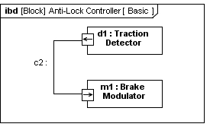
Block Definition vs. Usage
Block Definition Diagram Internal Block Diagram
Definition
Block is a definition/type
Captures properties, etc.
Reused in multiple contexts
Usage
Part is the usage of a block in the context of a composing block
Also known as a role
4/15/2008
Copyright © 2006-2008 by Object Management Group.

Slide 27
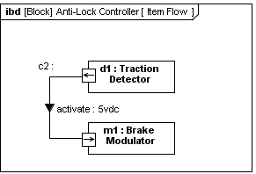





Internal Block Diagram (ibd)
Blocks, Parts, Ports, Connectors & Flows
Enclosing Block
Connector Item Flow
Port
Part
Internal Block Diagram Specifies Interconnection of Parts
4/15/2008
Copyright © 2006-2008 by Object Management Group.

Slide 28
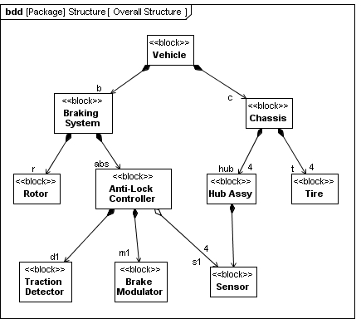
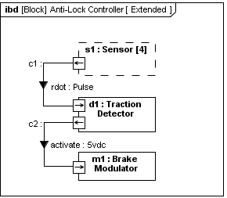
Reference Property Explained
S1 is a reference part*
Shown in dashed outline box
s
*Actual name is reference property
4/15/2008
Copyright © 2006-2008 by Object Management Group.

Slide 29

SysML Ports
Specifies interaction points on blocks and parts
  Integrates behavior with structure
  portName:TypeName
Kinds of ports
  Standard (UML) Port
    Specifies a set of required or provided operations and/or signals
    Typed by a UML interface
  Flow Port
    Specifies what can flow in or out of block/part
    Typed by a block, value type, or flow specification
    Atomic, non-atomic, and conjugate variations
Standard Port and Flow Port Support Different Interface Concepts
4/15/2008
Copyright © 2006-2008 by Object Management Group.

Slide 30







Port Notation
provided interface (provides the operations)
Standard Port
part1:
part2:
required interface (calls the operations)
Flow Port
Flow Port
part1:
part2:
item flow
4/15/2008
Copyright © 2006-2008 by Object Management Group.

Slide 31


Delegation Through Ports
Delegation can be used to preserve encapsulation of block (black box vs white box)
Interactions at outer ports of Block1 are delegated to ports of child parts
Ports must match (same kind, type, direction, etc.)
Connectors can cross boundary without requiring ports at each level of nested hierarchy
ibd [block]Block1[delegation]
Child1:
Child2:
4/15/2008
Copyright © 2006-2008 by Object Management Group.

Slide 32

Parametrics
Used to express constraints (equations) between value properties
  Provides support for engineering analysis (e.g., performance, reliability)
  Facilitates identification of critical performance properties
Constraint block captures equations
  Expression language can be formal (e.g., MathML, OCL) or informal
  Computational engine is provided by applicable analysis tool and not by SysML
Parametric diagram represents the usage of the constraints in an analysis context
  Binding of constraint parameters to value properties of blocks (e.g., vehicle mass bound to parameter ‘m’ in F= m × a)
Parametrics Enable Integration of Engineering Analysis with Design Models
4/15/2008
Copyright © 2006-2008 by Object Management Group.

Slide 33
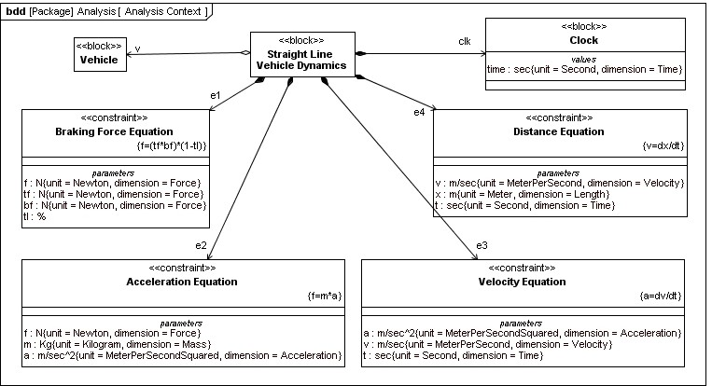
Defining Vehicle Dynamics
Defining Reusable Equations for Parametrics
4/15/2008
Copyright © 2006-2008 by Object Management Group.

Slide 34
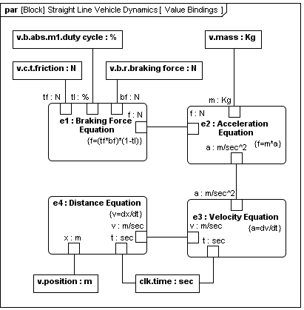
Vehicle Dynamics Analysis
Using the Equations in a Parametric Diagram to Constrain Value Properties
4/15/2008 Copyright © 2006-2008 by Object Management Group.
34

Slide 35
Behavioral Diagrams
SysML Diagram
Behavior Diagram |  |  | Requirement Diagram |  |  | Structure Diagram
Block Definition Diagram |  |  | Internal Block Diagram |  |  | Package Diagram
Activity Diagram
Sequence Diagram
State Machine Diagram
Use Case Diagram
Same as UML 2
Parametric Diagram
Modified from UML 2
New diagram type
4/15/2008
Copyright © 2006-2008 by Object Management Group.

Slide 36
Activities
Activity specifies transformation of inputs to outputs through a controlled sequence of actions
Secondary constructs show responsibilities for the activities using activity partitions (i.e., swim lanes)
SysML extensions to Activities
  Support for continuous flow modeling
  Alignment of activities with Enhanced Functional Flow Block Diagram (EFFBD)
4/15/2008
Copyright © 2006-2008 by Object Management Group.

Slide 37

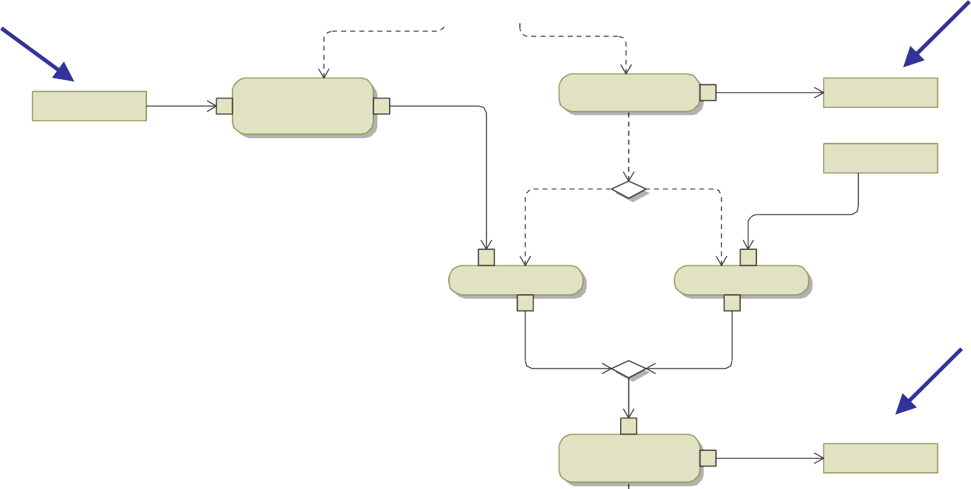


Activity Diagram
Activity
act Example
Output
Input
Action
in1
a2
out1
in1
a1
out1
out1
Input
[x>0]
[x<=0]
in2
in1
in1
a3
a4
Output
out1
out1
in1
a5
out1
out2
Activity Diagram Specifies Controlled Sequence of Actions
4/15/2008
Copyright © 2006-2008 by Object Management Group.

Slide 38



Routing Flows
Initial Node – On execution of parent control token placed on outgoing control flows
Activity Final Node – Receipt of a control token terminates parent
Flow Final Node – Sink for control tokens
Fork Node – Duplicates input (control or object) tokens from its input flow onto all outgoing flows
Join Node – Waits for an input (control or object) token on all input flows and then places them all on the outgoing flow
Decision Node – Waits for an input (control or object) token on its input flow and places it on one outgoing flow based on guards
Merge Node – Waits for an input (control or object) token on any input flows and then places it on the outgoing flow
Guard expressions can be applied on all flows
38

Slide 39
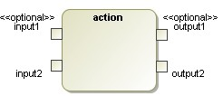

Actions Process Flow of Control and Data
Two types of flow
  Object / Data
  Control
Unit of flow is called a “token”
(consumed & produced by actions)
Control Input
Control Output
Actions Execution Begins When Tokens Are Available on “all” Control Inputs and Required Inputs
4/15/2008
Copyright © 2006-2008 by Object Management Group.

Slide 40


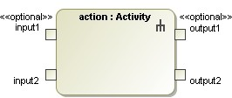
An Action Can Invoke Another Activity
act Activity
<<optional>>
input1
action1
<<optional>>
output1
input2
action2
output2
Control Input
Control Output
Activity is Invoked When an Action Begins to Execute
4/15/2008
Copyright © 2006-2008 by Object Management Group.

Slide 41
Semantics for Activity Invocation
A call behavior action can have
0..* control inputs & outputs
0 ..* optional item inputs & outputs
0..* required item inputs & outputs
0..* streaming (and continuous) item inputs & outputs
Note: The summary is an approximation of the semantics.
The detailed semantics are specified in the UML and SysML specification.
Starting an action:
An action starts when a token is placed on all of its control inputs and all of its required inputs (must meet minimum multiplicity of its input pins) and the previous invoked activity has completed
An action invokes an activity when it starts, and passes the tokens from its input pins to the input parameter nodes of the invoked activity
During an execution:
An action continues to accept streaming inputs and produce streaming outputs
Terminating an action:
An action terminates when its invoked activity reaches an activity final, or when the action receives a control disable, or as a side affect of other behaviors of the parent activity
The tokens on the output parameter nodes of the activity are placed on the output pins of the action and a control token is placed on each of the control outputs of the action
Following action termination:
The tokens on the output pins and control outputs of the action are moved to the input pins of the next actions when they are ready to start per above
The action can restart and invoke the activity again when the starting conditions are satisfied per above
4/15/2008
Copyright © 2006-2008 by Object Management Group.

Slide 42




Common Actions
act Activity
<<optional>>
input1
action1
<<optional>>
output1
input2
action2
output2
Call Operation Action
(can call leaf level function)
Call Behavior Action
Accept Event Action
(Event Data Pin often elided)
Send Signal Action
(Pins often elided)
4/15/2008
Copyright © 2006-2008 by Object Management Group.

Slide 43
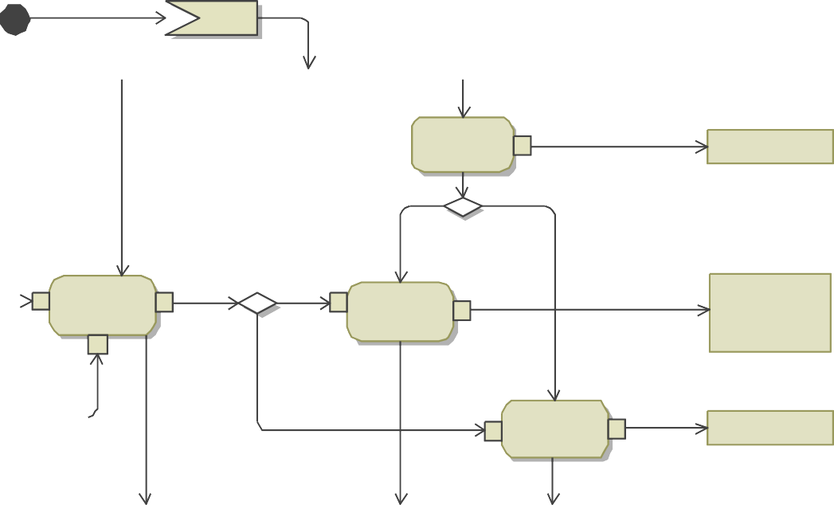

Activity Diagram Example With Streaming Inputs and Outputs
act Activity
Start
action 4
output3
out1
«optional»
in1
[x>1]
<<optional>>
input1
{stream}
[else]
action 1
[y>0]
<<optional>>
output1
{stream}
{stream}
«optional» out1
{stream}
«optional»
in1
{stream}
action 2
out1
{stream}
«optional»
in1
{stream}
action 3
in2
input2
[else]
output2
out1
Streaming Inputs and Outputs Continue to Be
Consumed and Produced
While the Action is Executing
4/15/2008
Copyright © 2006-2008 by Object Management Group.
43

Slide 44
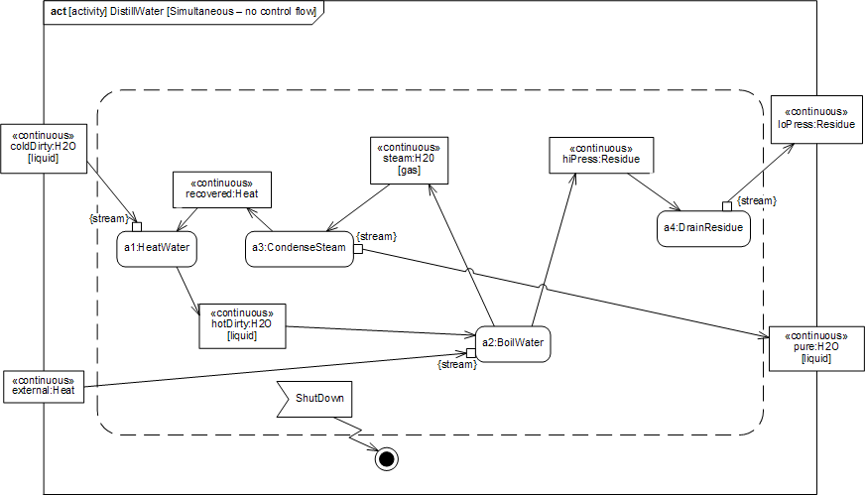

Distill Water Activity Diagram (Continuous Flow Modeling)
Continuous flow means ΔTime
between tokens approaches zero Continuous Flow
Actions are enabled by default when activity is enabled
Accept Event Action Will Terminate Execution
Interruptible Region
Continuous Flow Is Representative of Many Physical Processes
4/15/2008
Copyright © 2006-2008 by Object Management Group.
44

Slide 45

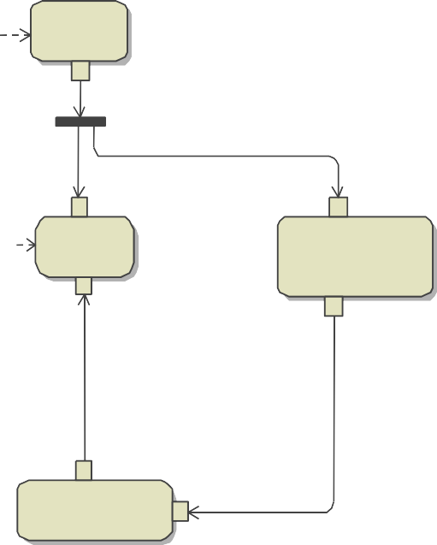


Example – Operate Car
act Operate Car
Turn Key to On
:Driving
Turn Key to Off
Brake Pressure
«continuous»
«continuous» Brake Pressure
:Braking
«continuous» Braking Pressure
«controlOperator»
:Enable on Brake Pressure > 0
Modulation Frequency
«continuous»
«optional »
«continuous» Modulation Frequency
:Monitor Traction
{control}
Enabling and Disabling Actions With Control Operators

Slide 46
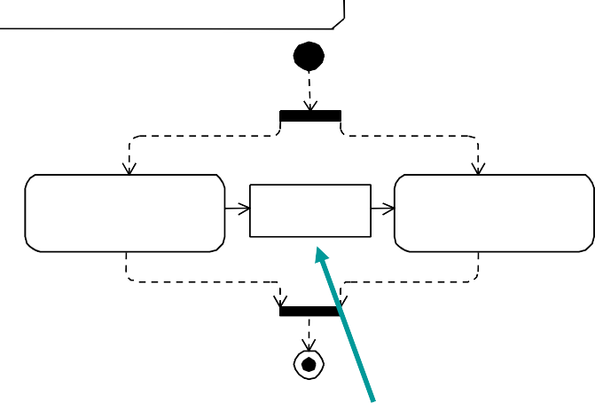
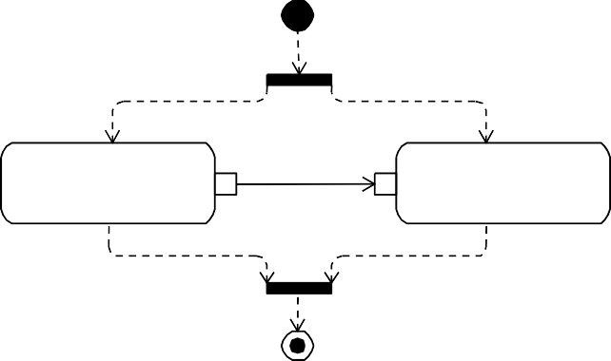
Activity Diagrams
Pin vs. Object Node Notation
Pins are kinds of Object Nodes
  Used to specify inputs and outputs of actions
  Typed by a block or value type
  Object flows connect object nodes
Object flows between pins have two diagrammatic forms
  Pins shown with object flow between them
  Pins elided and object node shown with flow arrows in and out
act [Activity] Prevent Lockup [ Actions ] act [Activity] Prevent Lockup [ Actions ]
Pins must have same characteristics (name, type etc.)
a1 : Detect Loss of Traction
p1 : TractLoss
of1
a2 : Modulate Braking Force
a1 : Detect Loss of Traction
tl : TractLoss
a2 : Modulate Braking Force
p2 : TractLoss
Pins
ObjectNode

Slide 47
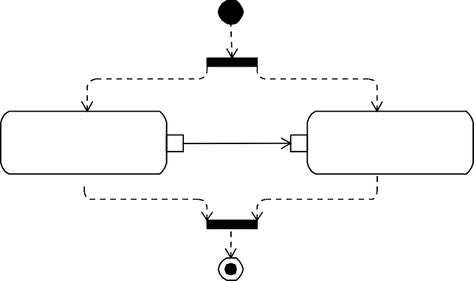

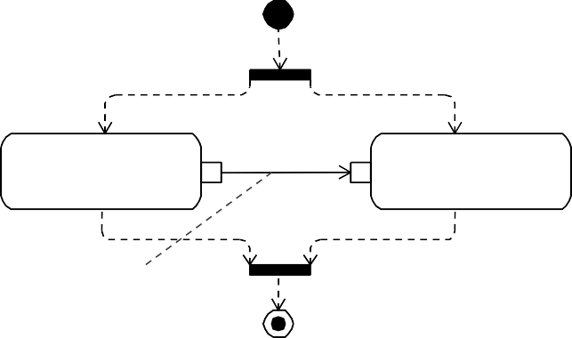

Explicit Allocation of Behavior to Structure Using Swimlanes
act [Activity] Prevent Lockup [ Actions ]
Activity Diagram (without Swimlanes)
a1 : Detect Loss of Traction
p1 : TractLoss
of1
a2 : Modulate Braking Force
p2 : TractLoss
act [Activity] Prevent Lockup [ Swimlanes ]
<<allocate>> d1 : Traction Detector
<<allocate>>
m1 : Brake Modulator
Activity Diagram (with Swimlanes)
a1 : Detect Loss of Traction
p1 : TractLoss
of1
a2 : Modulate Braking Force
p2 : TractLoss
allocatedTo
<<connector>> c2 :

Slide 48

Activity Decomposition
bdd | [Pa ckage] Beh avior [ Beh avior De comp ]
a1 <<activity>> De tect Los s of Tra ction |  | <<activity>> Prevent Loc kup p1 <<block>> Tra ctLoss | p2 | a2 <<activity>> Modulate Braki ng Force
act [Activity]
Prevent Lockup
[ Actions ]
a1 : Detect Loss of
Traction
p1 : TractLoss
of1
a2 : Modulate Braking Force
p2 : TractLoss
Definition
Use

Slide 49
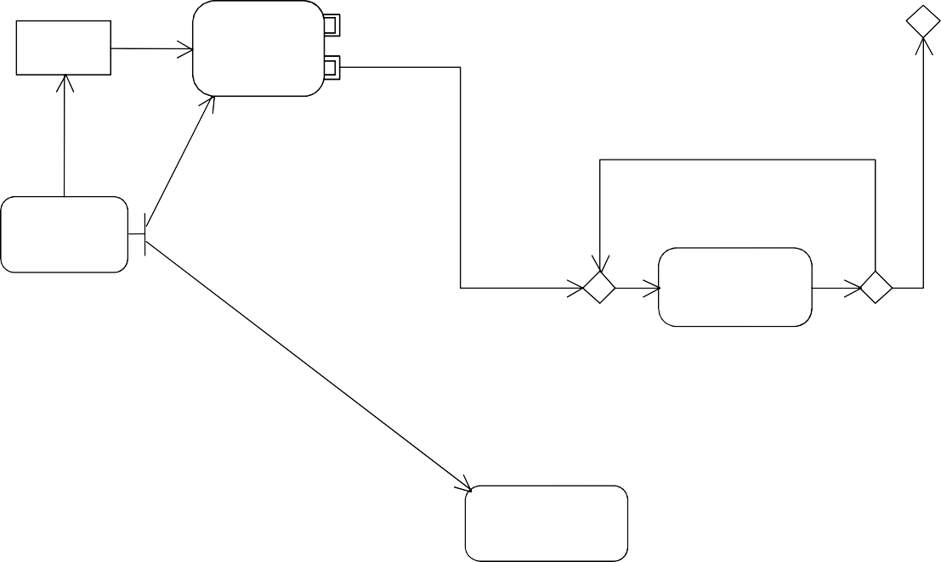



SysML EFFBD Profile
EFFBD - Enhanced Functional Flow Block Diagram
«effbd»
act
2.4 Function in Multi-exit Construct
{cc#1}
2.2 Multi- exit Function
«optional»
Item 1
{cc#2}
[ before third time ]
Item 2
External Input
2.1 Serial Function
«optional»
[ after third
External Output
2.5 Function in an Iterate
time ]
Item 3
«optional»
2.6 Output Function
2.3 Function in Concurrency
«optional»
Item 4
Aligning SysML with Classical Systems Engineering Techniques

Slide 50
Interactions
Sequence diagrams provide representations of message based behavior
  represent flow of control
  describe interactions between parts
Sequence diagrams provide mechanisms for representing complex scenarios
  reference sequences
  control logic
  lifeline decomposition
SysML does not include timing, interaction overview, and communications diagram

Slide 51
Black Box Interaction (Drive)
sd DriveBlackBox
driver:Driver
vehicle: H:ybridSUV
ref
StartVehicleBlackBox
par
alt controlSpeed
[state = (idle)]
ref
Idle
[state = (accelerating/cruising)]
ref
Accelerate/Cruise
[state = (braking)]
ref
Brake
ref
Steer
ref
Park/ShutdownVehicle
UML 2 Sequence Diagram Scales
by Supporting Control Logic and Reference Sequences
4/15/2008 Copyright © 2006-2008 by Object Management Group.
51

Slide 52
Black Box Sequence (StartVehicle)
^{sd} StartVehicleBlackBox
driver:Driver
vehicle:HybridSUV
ref StartVehicleWhiteBox
turnIgnitionToStart
1: StartVehicle
References Lifeline Decomposition For White Box
Interaction
Simple Black Box Interaction
4/15/2008
Copyright © 2006-2008 by Object Management Group.
52

Slide 53

White Box Sequence (StartVehicle)
^{sd} StartVehicleWhiteBox
ecu:PowerControlUnit
epc:ElectricalPowerController
1: StartVehicle
1.1: Enable
1.2:ready
Decomposition of Black Box Into White Box Interaction
4/15/2008
Copyright © 2006-2008 by Object Management Group.
52

Slide 54
Primary Interaction Operators
ref name
  reference to a sequence diagram fragment defined elsewhere
opt [condition]
  has 1 part that may be executed based on a condition/state value
alt
  has 2 or more parts, but only one executes based on a condition/state
  an operand fragment labeled [else] is executed if no other condition is true
par
  has 2 or more parts that execute concurrently
    Concurrence indicates does not require simultaneous, just that the order is undetermined. If there is only one processor the behavior could be (A then B), (B then A), or (A and B interleaving) …
loop min..max [escape]
  Has a minimum # of executions, and optional maximum # of executions, and optional escape condition
break [condition]
  Has an optional guard. If true, the contents (if any) are executed, and the remainder of the enclosing operator is not executed
Provided by Michael Chonoles
54

Slide 55
Other Interaction Operators
critical
  The sequence diagram fragment is a critical region. It is treated as atomic – no interleaving with parallel regions
neg
  The sequence diagram fragment is forbidden. Either it is impossible to occur, or it is the intent of the requirements to prevent it from occurring
assert
  The sequence diagram fragment is the only one possible (or legal)
seq (weak, the default)
strict
  Strict: The message exchange occurs in the order described
  Weak: Each lifeline may see different orders for the exchange (subject to causality)
consider (list of messages)
ignore (list of messages)
  Consider: List the messages that are relevant in this sequence fragment
  Ignored: List the messages that may arrive, but are not interesting here
Provided by Michael Chonoles
54

Slide 56




Trial Result of Vehicle Dynamics
timMaxAcceleration [100 Wheel Horsepower]
Satisfies
«requirementA» cceleration
«diagramDescriptio»n version=”0.1" description=”Constant
100 wheel horsepower, 4000 lb vehicle weight, simple drag" reference=”Equations of Motion” completeness=”assumes perfect tire traction”
0.5
0.45
0.4
0.35
0.3
0.25
0.2
0.15
0.1
0.05
0
Accelleration (g)
Lifeline are value properties
0 5
10
Time (sec)
15
20
140
120
100
80
60
40
20
0
Velocity (mph)
0
5
10
15
20
1800
1600
1400
1200
1000
800
600
400
200
0
Time (sec)
Timing Diagram Not Part of SysML
Distance (ft)
0
5
10
Time (sec)
15
20
Typical Example of a Timing Diagram
4/15/2008
Copyright © 2006-2008 by Object Management Group.

Slide 57
State Machines
Typically used to represent the life cycle of a block
Support event-based behavior (generally asynchronous)
  Transition with trigger, guard, action
  State with entry, exit, and do-activity
  Can include nested sequential or concurrent states
  Can send/receive signals to communicate between blocks during state transitions, etc.
Event types
  Change event
  Time event
  Signal event
4/15/2008
Copyright © 2006-2008 by Object Management Group.

Slide 58



Operational States (Drive)
stm HSUVOperationalStates
Off
keyOff/
start[in neutral]/start engine
shutOff/stop engine
Nominal states only
Operate
Transition notation: trigger[guard]/action
Idle
accelerate/
when (speed = 0)
releaseBrake/
Accelerating/ Cruising
Braking
engageBrake/
4/15/2008
Copyright © 2006-2008 by Object Management Group.

Slide 59
Use Cases
Provide means for describing basic functionality in terms of usages/goals of the system by actors
  Use is methodology dependent
  Often accompanied by use case descriptions
Common functionality can be factored out via
«include» and «extend» relationships
Elaborated via other behavioral representations to describe detailed scenarios
No change to UML
4/15/2008
Copyright © 2006-2008 by Object Management Group.

Slide 60
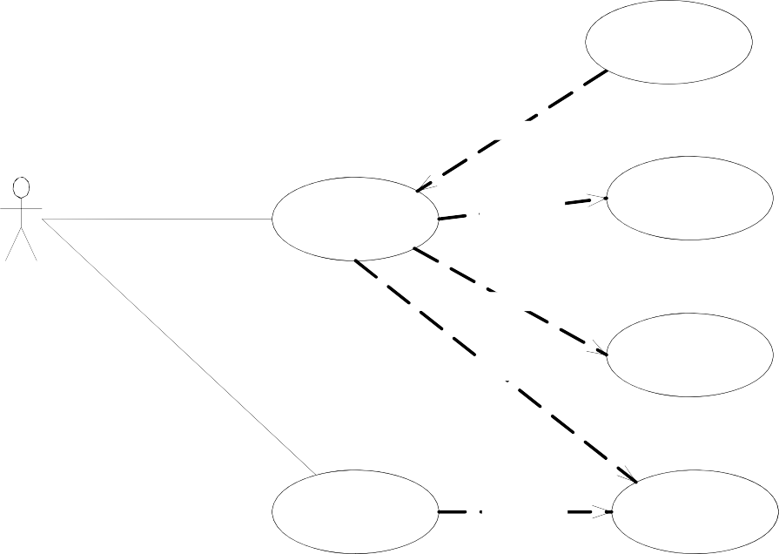
Operational Use Cases
uc HSUV_UseCases [Operational Use Cases]
HybridSUV
Flat_Tire
«extend»
Drive_The_Vehi cle
«include»
Accelerate
Driver
«include»
«include»
Steer
Park
«include»
Brake
4/15/2008
Copyright © 2006-2008 by Object Management Group.

Slide 61
Cross-cutting Constructs
Allocations
Requirements
SysML Diagram
Behavior Diagram
Requirement Diagram
Structure Diagram
Block Definition Diagram |  |  | Internal Block Diagram |  |  | Package Diagram
Activity Diagram
Sequence Diagram
State Machine Diagram
Use Case Diagram
Same as UML 2
Parametric Diagram
Modified from UML 2
New diagram type
4/15/2008
Copyright © 2006-2008 by Object Management Group.

Slide 62
Allocations
Represent general relationships that map one model element to another
Different types of allocation are:
  Behavioral (i.e., function to component)
  Structural (i.e., logical to physical)
  Software to Hardware
– ….
Explicit allocation of activities to structure via swim lanes (i.e., activity partitions)
Both graphical and tabular representations are specified
4/15/2008
Copyright © 2006-2008 by Object Management Group.

Slide 63

Different Allocation Representations (Tabular Representation Not Shown)
«allocate»
part name : Element Name
Element Name2
Element Name1
«allocate»
action name : Activity Name
«allocate»
Element Name3
Allocate Relationship
Explicit Allocation of Action to Part Property
«block» Block Name
«block» Block Name
allocatedFrom
«elementType»Element Name
part name
allocatedFrom
«elementType» ElementName
part name
Compartment Notation
Callout Notation
Read as follows: “part name has constraints that are allocated to/from an <<element type>> Element Name”
4/15/2008
Copyright © 2006-2008 by Object Management Group.

Slide 64
SysML Allocation of SW to HW
In UML, the deployment diagram is used to deploy artifacts to nodes
In SysML, «allocation» on an ibd and bdd is used to deploy software/data to hardware
ibd [node] SF Residence
«hardware »
: Optical Sensor
*
2
«hardware »
: Video Camera
«hardware »
: Alarm
«hardware »
: Site Processor
allocatedFrom
«software» Device Mgr
«software» Event Mgr
«software» Site Config Mgr
«software» Site RDBMS
«software» Site Status Mgr
«software» User I/F
«software» User Valid Mgr
«hardware »
: NW Hub
«hardware »
: DSL Modem
allocatedFrom
«software» SF Comm I/F
«hardware »
: DVD-ROM Drive
2
allocatedFrom
«data» Video File
«hardware »
: User Console
«hardware »
: Site Hard Disk
allocatedFrom
«data» Site Database
4/15/2008
Copyright © 2006-2008 by Object Management Group.

Slide 65
Requirements
The «requirement» stereotype represents a text based requirement
  Includes id and text properties
  Can add user defined properties such as verification method
  Can add user defined requirements categories (e.g., functional, interface, performance)
Requirements hierarchy describes requirements contained in a specification
Requirements relationships include DeriveReqt, Satisfy, Verify, Refine, Trace, Copy
4/15/2008
Copyright © 2006-2008 by Object Management Group.

Slide 66

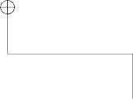

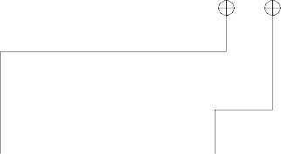
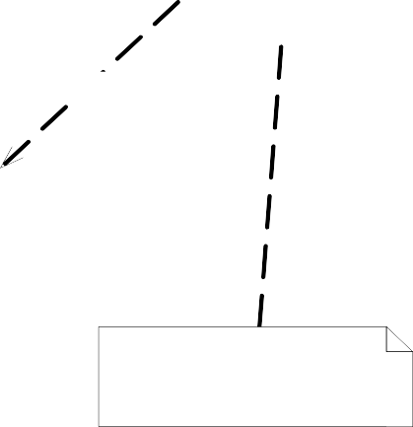
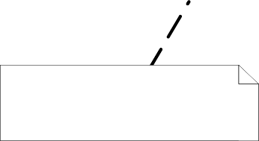

Requirements Breakdown
req [package] HSUVRequirements [HSUV Specification]
HSUVSpecification
RefinedBy
«useCase» HSUVUseCases::Accelerate
«requirement» Eco-Friendliness
«requirement» Performance
«requirement» Power
«deriveReqt»
«requirement» Braking
«requirement» FuelEconomy
«requirement» Acceleration
«requirement» Emissions
Id = “R1.2.1”
text = “The vehicle shall meet Ultra-Low Emissions Vehicle standards.”
VerifiedBy
«testCase» MaxAcceleration
SatisfiedBy
«block» PowerSubsystem
Requirement Relationships Model the Content of a Specification
4/15/2008
Copyright © 2006-2008 by Object Management Group.

Slide 67

Example of Derive/Satisfy Requirement Dependencies
«requirement» OffRoadCapability
«requirement» Acceleration
«requirement» CargoCapacity
Supplier
«deriveReqt»
«deriveReqt»
«deriveReqt»
Client
«requirement» Power
Client depends on supplier (i.e., a change in supplier results in a change in client)
Supplier
«satisfy»
Client
«block» PowerSubsystem
from OMG
Arrow Direction Opposite Typical Requirements ^{f}F^{rom O}l^{M}o^{G} w-Down
4/15/2008
Copyright © 2006-2008 by Object Management Group.

Slide 68
Problem and Rationale
bdd Master Cylinder requirements
«requirement»
Loss of Fluid
«block»
Brake System
«satisfy»
m:MasterCylinder
«requirement»
Reservoir
«satisfy»
«rationale»
The best-practice solution consists in assigning one reservoir per brakeline. See "automotive_d32_hdb.doc"
«problem»
The master cylinder in previous version leaked.
Problem and Rationale can be attached to any Model Element to Capture Issues and Decisions
4/15/2008
Copyright © 2006-2008 by Object Management Group.

Slide 69
Stereotypes & Model Libraries
Mechanisms for further customizing SysML
Profiles represent extensions to the language
  Stereotypes extend meta-classes with properties and constraints
    Stereotype properties capture metadata about the model element
  Profile is applied to user model
  Profile can also restrict the subset of the meta-model used when the profile is applied
Model Libraries represent reusable libraries of model elements
4/15/2008
Copyright © 2006-2008 by Object Management Group.

Slide 70
Stereotypes
«metaclass»
NamedElement
«configurationItem»
Engine
author=”John Doe” version=”1.2" lastChanged=Dec12, 2005
«stereotype»
ConfigurationItem
author: String version: String lastChanged: Date
Defining the Stereotype
Applying the Stereotype
4/15/2008
Copyright © 2006-2008 by Object Management Group.

Slide 71

Applying a Profile and Importing a Model Library
pkg ModelingDomain [Establishing HSUV Model]
«profile»
SysML
«apply» {strict}
«apply»
{strict}
«modelLibrary»
SI Definitions
HSUVModel
«import»
4/15/2008
Copyright © 2006-2008 by Object Management Group.

Slide 72
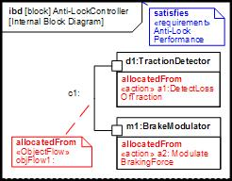
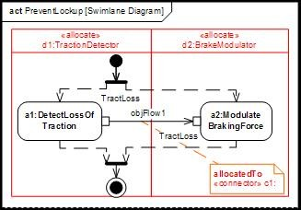
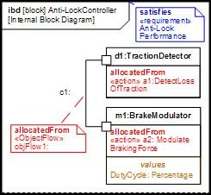
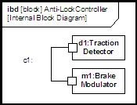
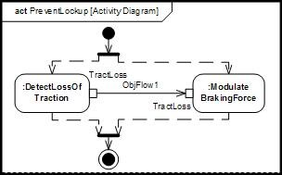
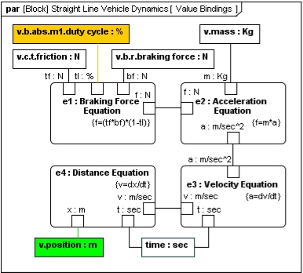
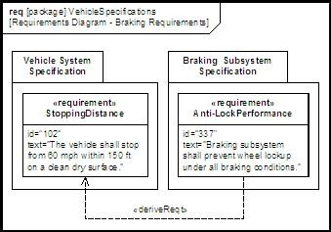
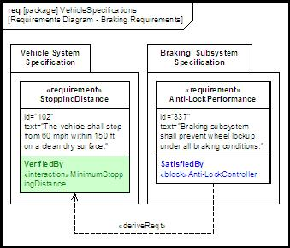

Cross Connecting Model Elements
1. Structure 2. Behavior
satisfy
3. Requirements
4. Parametrics
72
4/15/2008 Copyright © 2006-2008 by Object Management Group.

Slide 73
SysML Modeling
as Part of the SE Process

Slide 74
Distiller Sample Problem
Refer to Chapter 15
“A Practical Guide to SysML”

Slide 75
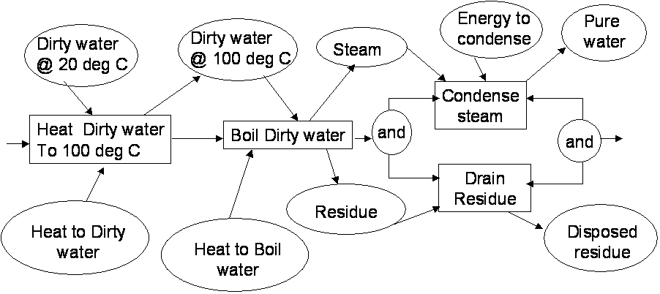
Distiller Problem Statement
The following problem was posed to the SysMLteam in Dec ’05 by D. Oliver:
Describe a system for purifying dirty water.
  Heat dirty water and condense steam are performed by a Counter Flow Heat Exchanger
  Boil dirty water is performed by a Boiler
  Drain residue is performed by a Drain
  The water has properties: vol = 1 liter, density 1 gm/cm3, temp 20 deg C, specific heat 1cal/gm deg C, heat of vaporization 540 cal/gm.
A crude behavior diagram is shown.
What are the real requirements? How do we design the system?
75

Slide 76
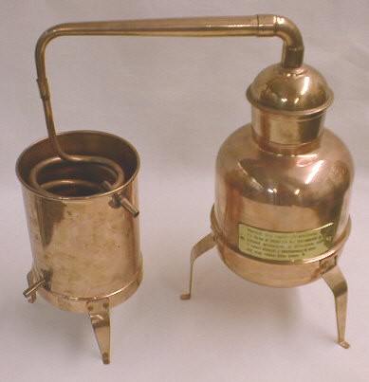
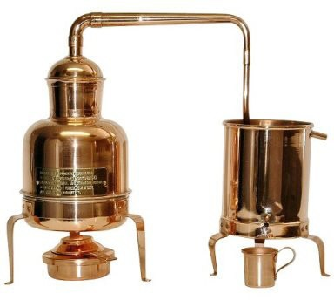
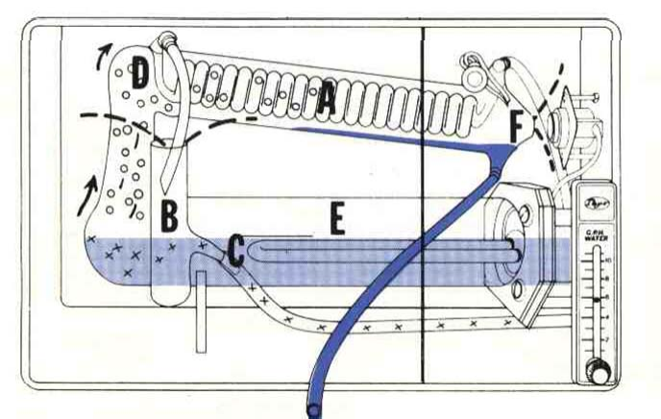
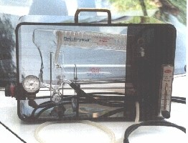
Distiller Types
Batch Distiller
Continuous Distiller
Note: Not all aspects of the distiller are modeled in the example
75

Slide 77
Distiller Problem – Process Used
Organize the model, identify libraries needed
List requirements and assumptions
Model behavior
  In similar form to problem statement
  Elaborate as necessary
Model structure
  Capture implied inputs and outputs
    segregate I/O from behavioral flows
  Allocate behavior onto structure, flow onto I/O
Capture and evaluate parametric constraints
  Heat balance equation
Modify design as required to meet constraints
Model the user interaction
Modify design to reflect user interaction
75

Slide 78
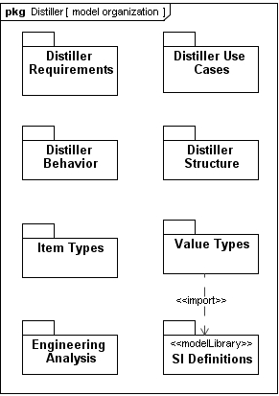
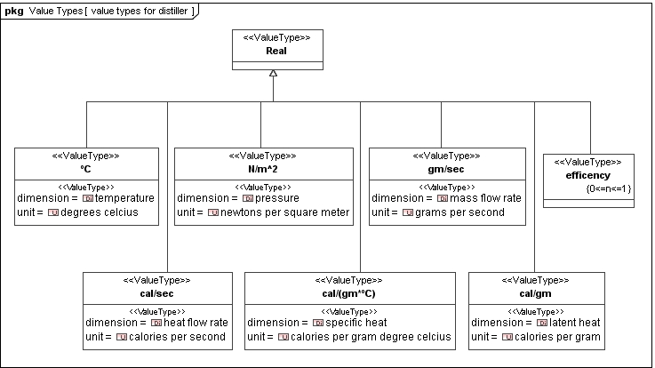
Distiller Problem – Package Diagram: Model Structure and Libraries
75

Slide 79
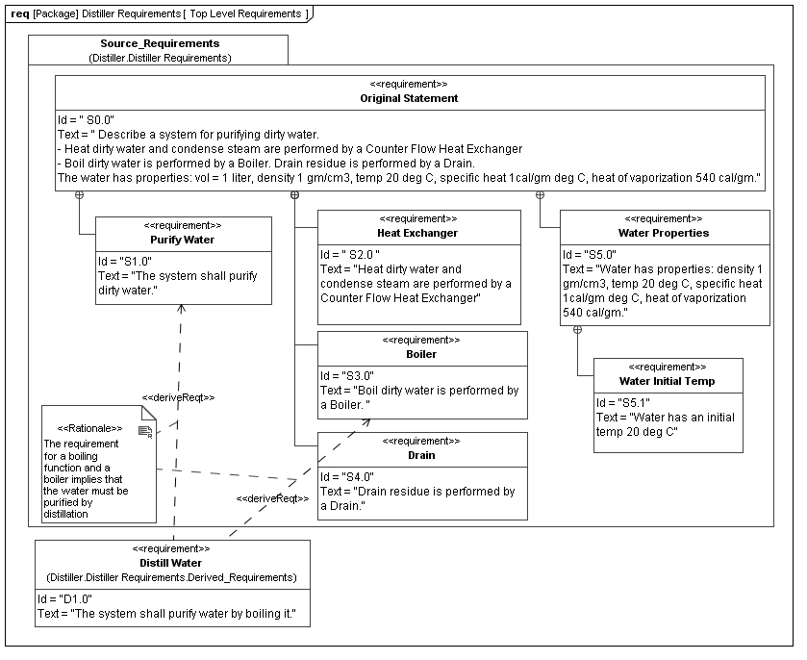
Distiller Example Requirements Diagram
75

Slide 80
Distiller Example: Requirements Tables
table [requirement] OriginalStatement[Decomposition of OriginalStatement]
id | name | text
S0.0 | OriginalStatement | Describe a system for purifying dirty water. …
S1.0 | PurifyWater | The system shall purify dirty water.
S2.0 | HeatExchanger | Heat dirty water and condense steam are performed by a …
S3.0 | Boiler | Boil dirty water is performed by a Boiler.
S4.0 | Drain | Drain residue is performed by a Drain.
S5.0 | WaterProperties | water has properties: density 1 gm/cm3, temp 20 deg C, …
S5.1 | WaterInitialTemp | water has an initial temp 20 deg C
table [requirement] PurifyWater[Requirements Tree]
id | name | relation | id | name | Rationale
S1.0 | PurifyWater | deriveReqt | D1.0 | DistillWater | The requirement for a boiling function and a boiler implies that the water must be purified by distillation
75

Slide 81
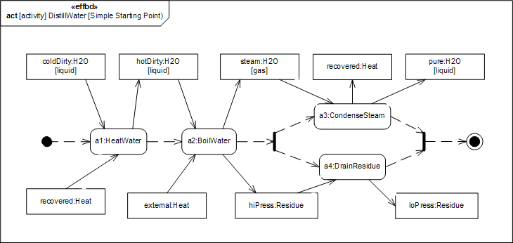
Distiller Example – Activity Diagram: Initial Diagram for DistillWater
This activity diagram applies the SysML EFFBD profile, and formalizes the diagram in the problem statement.
Energy to _{Pure}
_{Dirty water} Dirty water condense _{water @ 20 deg C} @ 100 deg C ^{Steam}
Condense steam
Heat Dirty water _{Boil Dirty water} and _{andand}
To 100 deg C
Drain Residue
Residue
Heat to Dirty Disposed
water ^{Heat to Boil} residue
water
Actions (Functions)
Control (Sequence) Things that flow (ObjectNodes)
75

Slide 82

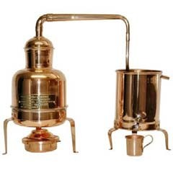
Distiller Example – Activity Diagram: Control-Driven: Serial Behavior
«effbd»
act [activity] DistillWater [Simple Starting Point)
recovered:Heat
pure:H2O
steam:H2O [gas]
[liquid]
coldDirty:H2O
[liquid]
hotDirty:H2O [liquid]
a3:CondenseSteam
a1:HeatWater
a2:BoilWater
a4:DrainResidue
external:Heat
discharge :Residue
predischarge :Residue
Batch Distiller
Continuous Distiller Here
75

Slide 83
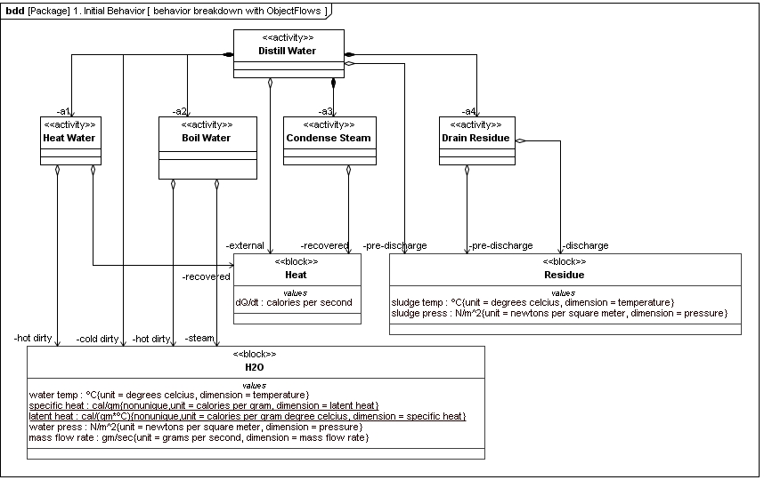

Distiller Example – Block Definition Diagram: DistillerBehavior
Activities (Functions)
Control (not shown on BDD)
Need to consider phases of H₂0
Things that flow (ObjectNodes)
75

Slide 84

Distiller Example – State Machine Diagram: States of H2O
States
Transitions
75

Slide 85

Distiller Example – Activity Diagram: I/O Driven: Continuous Parallel Behavior
Continuous Distiller
Batch Distiller Here
75

Slide 86

Distiller Example – Activity Diagram: No Control Flow, ActionPin Notation, Simultaneous Behavior
75

Slide 87

Distiller Example – Activity Diagram (with Swimlanes): DistillWater
Parts
4/15/2008 ^{Allocated ibd} Copyright © 2006-2008 by Object Management Group.
87

Slide 88

Distiller Example – Block Definition Diagram: DistillerStructure
88

Slide 89










Distiller Example – Block Definition Diagram: Heat Exchanger Flow Ports
bdd Initial Distiller Structure [ distiller breakdown (ports) ]
pkg
<<block>>
Distiller
condenser | evaporat
<<block>>
Heat Exchanger
constraints
{h out.temp<=120, c in.temp<=60, h in.temp<=120, c out.temp<=90}
or
drain
<<block>>
in : Fluid
<<block>>
Valve
out : Fluid
c in : Fluid
h in : Fluid
middle : Fluid
Boiler
top : Fluid
c out : Fluid
h out : Fluid bottom : Fluid
bottom : Heat
Constraints (on Ports)
Flow Ports
(typed by things that flow)
88

Slide 90

Distiller Example – Internal Block Diagram: Distiller Initial Design
ibd
88

Slide 91

Distiller Example –Table: Functional Allocation
Exercise for student:
Is allocation complete? Where is “«objectFlow»of8”?
Swimlane Diagram
88

Slide 92

Parametric Diagram: Heat Balance
88

Slide 93


Distiller Example – Heat Balance Results
table IsobaricHeatBalance1 [Results of Isobaric Heat Balance]
specific heat cal/gm-°C
1
main1 : H2O
main2 : H2O frm condenser
latent heat cal/cm
540
Satisfies «requirement» WaterSpecificHeat
Satisfies «requirement» WaterHeatOfVaporization
main2 : H2O into evap
main3 : H2O
main4 : H2O
Satisfies «requirement»
Set these (steady state)
Solve for these
WaterInitialTemp
mass flow rate gm/sec
6.8
6.8
1 1 1
temp °C
20
100
100 100 100
dQ/dt cooling water cal/sec | 540
dQ/dt steam-condensate cal/sec | 540
condenser efficency | 1
heat deficit | 0
Note: Cooling water needs to have 6.75x
flow of steam!
Need bypass between hx_water_out and bx_water_in!
dQ/dt condensate-steam cal/sec | 540
boiler efficiency | 1
dQ/dt in boiler cal/sec | 540
88

Slide 94

Distiller Example – Activity Diagram: Updated DistillWater
88

Slide 95

Distiller Example – Internal Block Diagram: Updated Distiller
ibd
4/15/2008 Copyright © 2006-2008 by Object Management Group. 95

Slide 96
Distiller Example – Use Case and Sequence Diagrams
sd [Interaction] Operational Sequence [ simple seqence ]
: Operator
<<block>>
: Distiller
uc [Package] Distiller Use Cases [ use case example ]
Distiller
1: Turn On
Operator
2: Power Lamp On
Operate Distiller
3: Operating Lamp On
loop
rating]
[while state=Ope
per
ini
alt
[level=high]
4: High Level Lamp On
[level=low]
5: Low Level Lamp On
[state=drain
ing residue]
6: Draining Lamp On
7: Turn Off
8: Power Lamp Off
96

Slide 97


Distiller Example – Internal Block Diagram: Distiller Controller
ibd Distiller [ block diagram revised & elaborated]
diverter assembly
class
splitter : Tee Fitting
m2.2 : H2O
m2.1 : H2O
feed : Valve
main1 : H2O
main2 : H2O
sludge1 : Residue
sludge2 : Residue
v : V Ctrl
m2.1 : H2O
condenser : Heat Exchanger
evaporator : Boiler
drain : Valve
c : Boiler Signals
p in : Elec Power
v : V Ctrl
main3 : H2O
htr pwr : Elec Power
blr ctl : Blr Sig
feed ctl : V Ctrl
main4 : H2O
drain ctl : V Ctrl
distiller pwr : Elec Power
blr status : Blr Sig
pwr in : Elec Power
v2 : V Ctrl
b : Boiler Signals bp : Elec Power
heat & valve : Controller
v1 : V Ctrl
user : Control Panel
pwr : Elec Power
iPanel
iPanel
96

Slide 98
Distiller Example – State Machine Diagram: Distiller Controller
stm Controller State Machine [ simple diagram]
[power = on]
Off
[bx level low]
do /Power Light Off
Filling
do /open feed : Valve
Operating
do /bx heater on
[bx1 level high]
Draining
do /open drain : Valve
[bx1 level low]
Level Low
do /open feed : Valve
Level OK
do /shut all Valves
Level High
do /open drain : Valve
[bx1 temp = 30]
[NOT bx1 level low]
Warming Up
do /bx1 heater on
[NOT bx1 level low]
[NOT bx1 level high]
Cooling Off
entry /bx1 heater OFF
do /open feed : Valve, open drain : Valve
Building Up Residue ^{[residue timer]} Purging Residue
do /close drain : Valve [drain timer] do /open drain : Valve
[bx1 temp = 100]
[shutdown command]
96

Slide 99
OOSEM – ESS Example
Refer to Chapter 16
“A Practical Guide to SysML”

Slide 100
System Development Process
Stakeholder Reqts
Manage System Development
Plan
Status Technical data
Test procedures
Define System Reqt's & Design
Integrate & Test System
System
System arch Allocated reqt's
Procedures
System Modeling Activities
Verified System Component
Data Hardware Software Develop
System Components
Component Modeling Activities
Integrated Product Development (IPD) is essential to improve communications
A Recursive V process that can be applied to multiple levels of the system hierarchy
Copyright © Lockheed Martin Corporation 2000 – 2003 & INCOSE 2004-2006
100
Copyright © 2006-2008 by Object Management Group.

Slide 101
System Modeling Activities – OOSEM
Integrating MBSE into the SE Process
Major SE Development Activities
Analyze Needs
Causal analysis
Mission use cases/scenarios
Enterprise model
Define System Requirements
System use cases/scenarios
Elaborated context
Define Logical Architecture
Logical decomposition
Logical scenarios
Logical subsystems
Optimize & Evaluate Alternatives
Parametric Diag
Trade study
Synthesize Allocated Architecture
Node diagram
HW, SW, Data arch
System deployment
Manage Requirements
Reqt’s Diagram & tables
Support Validation & Verification
Test cases
Test procedures
Common Subactivities
Copyright © 2006-2008 by Object Management Group.
101
Copyright © Lockheed Martin Corporation 2000 – 2003 & INCOSE 2004-2006

Slide 102
Enhanced Security System Example
The Enhanced Security System is the example for the OOSEM material
  Problem fragments used to demonstrate principles
  Utilizes Artisan RTS™ Tool (early version) for the SysML artifacts
Copyright © Lockheed Martin Corporation 2000 – 2003 & INCOSE 2004-2006102
Copyright © 2006-2008 by Object Management Group.
2006102

Slide 103


ESS Requirements Flowdown
req [package] ESS Requirements Flowdown
«document»
Market Needs
«trace»
ESS Enterprise Models
«trace»
«requirement»
ESS System Specification
«satisfy»
ESS System Models
id# = SS1
«refine»
«requirement»
IntruderDetection
«requirement»
R111
id# = SS102
txt = System shall detect intruder entry and exit ...
«deriveReqt» ^{id# = SS111}
«satisfy»
«requirement»
ESS Logical Requirements
«refine»
ESS Logical Design Models
satisfiedBy
Entry/Exit Subsystem
verifiedBy
Entry/Exit Detection Test
id# = LR1
«deriveReqt»
«satisfy»
«requirement»
ESS Allocated Requirements
ESS Allocated Design Models
id# = AR1
«refine»
Copyright © Lockheed Martin Corporation 2000 – 2003 & INCOSE 2004-2006103
Copyright © 2006-2008 by Object Management Group.
2006103

Slide 104




Operational View Depiction
bdd [package] Enterprise (As Is)
Central Monitoring Station As-Is
Comm Network
Residence
Dispatcher
Intruder
Police
Copyright © Lockheed Martin Corporation 2000 – 2003 & INCOSE 2004-2006104
Copyright © 2006-2008 by Object Management Group.
2006104

Slide 105

ESS Enterprise As-Is Model
Copyright © Lockheed Martin Corporation 2000 – 2003 & INCOSE 2004-2006105
Copyright © 2006-2008 by Object Management Group.
2006105

Slide 106

ESS Operational Enterprise To-Be Model
Copyright © Lockheed Martin Corporation 2000 – 2003 & INCOSE 2004-2006106
Copyright © 2006-2008 by Object Management Group.
2006106

Slide 107

System Use Cases - Operate
uc [package] System Use Cases
Activate/Dea- ctivate
«include»
Operate
«include»
«extend»
Monitor Site
Respond
Respond to Break-In
Respond to Fire
Respond to Medical
Copyright © Lockheed Martin Corporation 2000 – 2003 & INCOSE 2004-2006107
Copyright © 2006-2008 by Object Management Group.
2006107

Slide 108
System Scenario: Activity Diagram Monitor Site (Break-In)
act Monitor Site (break in)
«actor» Intruder
«system» ESS
«external» Emergency Services
Enter Property
System On
Status Update
System Off
DetectEntry
ValidateEntry
Validated Entry
Conduct Theft
GenerateAlarm
ReportEntry
[Alert]
Exit Property
Assess Report
InternalMonitor
[Alert]
DetectExit
Report Update
Dispatch Police
ReportExit
[Alert]
Copyright © Lockheed Martin Corporation 2000 – 2003 & INCOSE 2004-2006108
Copyright © 2006-2008 by Object Management Group.
2006108

Slide 109

ESS Elaborated Context Diagram
Copyright © Lockheed Martin Corporation 2000 – 2003 & INCOSE 2004-2006109
Copyright © 2006-2008 by Object Management Group.
2006109

Slide 110

ESS Logical Decomposition (Partial)
110

Slide 111

Detect Entry Scenario
act detectEntry
«subsystem» entry/exit subsystem
«logical»
Entry Sensor
«logical» Entry/Exit Monitor
«logical» Event Monitor
«continuous» Door Input
«continuous» Window Input
Alert Status
di : Door Input
ee : SensedEntry
wi : Window Input
estatus
status
Record Event
Sense State Change
Detect Event
sensor : SensorOutput _{status}[State=BreakInResponse]
log : Event
[Else]
«store» Event Log
110

Slide 112
Elaborating Logical Component
«logical»
Entry Sensor
«logical»
Entry/Exit Monitor
«logical»
Event Monitor
Sense State Change()
Detect event()
Record event()
«store»: Event Log
Added operations from Detect Entry / Detect Exit logical scenario
These operations support entry/exit subsystem
110

Slide 113

ESS Logical Design – Example Subsystem
Copyright © Lockheed Martin Corporation 2000 – 2003 & INCOSE 2004-2006
113
Copyright © 2006-2008 by Object Management Group.

Slide 114

ESS Logical Design (Partial)
ibd [system] ESS
«logical»
: Alarm Generator
: AlarmSignal
: Window Input
«logical»
: Entry Sensor
: Door Input
: SensedEntry
: AlarmCmd
: BIT
«logical»
: Entry/Exit Monitor
: Alert Status
«logical»
: Alarm I/F
: Window Input
: Entry/Exit Alert Status
«logical»
: Exit Sensor
: SensedExit
«logical»
: Event Monitor
: Door Input
«logical»
: Emergency Monitor
«store»
: Event Log
: Alert Status
: BIT
: EmergencyData
«logical»
: Perimeter Sensor
: BIT
«logical»
: Fault Mgr
«logical»
: Emer Serv I/F
: Emergency ServicesOut
: BIT
: Fault
«logical»
: Environment Sensor
«logical»
: Customer Output Mgr
: FaultReport
«logical»
: Customer I/F
: Lamp
Copyright © Lockheed Martin Corporation 2000 – 2003 & INCOSE 2004-2006
113
Copyright © 2006-2008 by Object Management Group.

Slide 115
ESS Allocation Table (partial)
Allocating Logical Components to HW, SW, Data, and Procedures components
 |  |  | Logical Components
Physical Components | Type |  | Entry Sensor | Exit Sensor | Perimeter Sensor | Entry/Exit Monitor | Event Monitor | Site Comms I/F | Event Log | Customer I/F | Customer Output Mgr | System Status | Fault Mgr | Alarm Generator | Alarm I/F
 | «software» | Device Mgr |  |  |  |  |  |  |  |  |  |  |  |  | X
 |  | SF Comm I/F |  |  |  |  |  | X
 |  | User I/F |  |  |  |  |  |  |  |  | X
 |  | Event Mgr |  |  |  | X | X
 |  | Site Status Mgr |  |  |  |  |  |  |  |  |  |  | X
 |  | Site RDBMS |  |  |  |  |  |  | X |  |  | X
 |  | CMS RDBMS |  |  |  |  |  |  | X
 | «data» | Video File |  |  |  |  |  |  | X
 |  | CMS Database |  |  |  |  |  |  | X
 |  | Site Database |  |  |  |  |  |  | X |  |  | X
 | «hardware» | Optical Sensor | X | X
 |  | DSL Modem |  |  |  |  |  | X
 |  | User Console |  |  |  |  |  |  |  | X
 |  | Video Camera |  |  | X
 |  | Alarm |  |  |  |  |  |  |  |  |  |  |  | X
Copyright © Lockheed Martin Corporation 2000 – 2003 & INCOSE 2004-2006
113
Copyright © 2006-2008 by Object Management Group.

Slide 116

ESS Deployment View
Copyright © Lockheed Martin Corporation 2000 – 2003 & INCOSE 2004-2006
113
Copyright © 2006-2008 by Object Management Group.

Slide 117

ESS Parametric Diagram To Support Trade-off Analysis
Copyright © Lockheed Martin Corporation 2000 – 2003 & INCOSE 2004-2006
113
Copyright © 2006-2008 by Object Management Group.

Slide 118
Entry/Exit Test Case
sd Entry/Exit Detection Test
Description
«testComponent»
:IntruderEmulator
«sut»
«hardware»
«sut»
«hardware»
Window[4]
/:Optical Sensor
«sut»
«hardware»
:Site Processor
«sut»
«hardware»
:DSL Modem
Door[1]
/:Optical Sensor
seq
seq
Intruder enters through front
Enter
door
Door sensor detects entry
: SensedEntry
New alert status sent to central
IntruderEntry : Alert Status
system
Intruder leaves through lounge
Exit
window
Window sensor detects exit
: SensedExit
Changed alert status sent to
Intruder Exit : Alert Status
central system
Copyright © Lockheed Martin Corporation 2000 – 2003 & INCOSE 2004-2006
113
Copyright © 2006-2008 by Object Management Group.

Slide 119

OOSEM Browser View Artisan Studio™ Example
4/15/2008 119
Copyright © 2006-2008 by Object Management Group.
Copyright © Lockheed Martin Corporation 2000 – 2003 & INCOSE 2004-2006

Slide 120
SysML in a Standards Framework

Slide 121




















Systems Engineering Standards Framework (Partial List)
Process Standards
EIA 632 ISO 15288 IEEE 1220 CMMI
Architecture Frameworks
FEAF DoDAF MODAF Zachman FW
Modeling Methods
HP OOSE SADT Other
Modeling & Simulation Standards
SysML
IDEF0 MARTE HLA MathML
System Modeling Simulation & Analysis
Interchange & Metamodeling Standards
MOF
XMI
STEP/AP233
4/15/2008
Copyright © 2006-2008 by Object Management Group.

Slide 122

























ISO/IEC 15288
System Life Cycle Processes
Enterprise Processes
Project Processes
Technical Processes
5.3.2
Enterprise Environment Management Process
5.5.2
Stakeholder Reqts Definition Process
5.4.2
Project Planning Process
5.3.3
Investment Management Process
5.5.3
Reqts Analysis Process
5.4.3
Project Assessment Process
5.5.4
Architectural Design Process
5.3.4
System Life Cycle Processes Management
5.4.4
Project Control Process
5.5.5
Implementation Process
5.3.5
Quality Management Process
5.5.6
Integration Process
5.4.5
Decision-Making Process
5.3.6
Resource Management Process
5.5.7
Verification Process
5.4.6
Risk Management Process
5.5.8
Transition Process
5.5.9
Validation Process
Agreement Processes
5.4.7
Configuration Management Process
5.5.10
Operation Process
5.2.2
Acquisition Process
5.5.11
Maintenance Process
5.2.3
Supply Process
5.4.8
Information Management Process
5.5.12
Disposal Process
4/15/2008
Copyright © 2006-2008 by Object Management Group.

Slide 123





Standards-based Tool Integration with SysML
Systems Modeling Tool
Other Engineering Tools
Model/Data Interchange
AP233/XMI
.....
•
-
-
-
-
-
-
-
-
-
-
-
-
-
-
-
-
-
-
-
-
-
-
-
-
-
-
-
-
-
-
-
-
.....
.....
AP233/XMI
4/15/2008
Copyright © 2006-2008 by Object Management Group.

Slide 124
Participating SysML Tool Vendors
Artisan (Studio)
EmbeddedPlus (SysML Toolkit)
– 3rd party IBM vendor
No Magic (Magic Draw)
Sparx Systems (Enterprise Architect)
IBM (Tau and Rhapsody)
TopCased
Visio SysML template
4/15/2008
Copyright © 2006-2008 by Object Management Group.

Slide 125
Transitioning to SysML

Slide 126


Using Process Improvement To Transition to SysML
126

Slide 127
MBSE Transition Plan
MBSE Scope
MBSE Responsibilities/Staffing
Process guidance
  High level process flow (capture in SEMP)
  Model artifact checklist
  Tool specific guidance
Tool support
  Modeling tool
  Requirements management
  CM
Training
Schedule
126

Slide 128
Typical Integrated Tool Environment
Project Management
Requirements Management
SoS/ DoDAF / Business Process Modeling
CM/DM
Product Data Management
Simulation & Visualization
Verification & Validation
Engineering Analysis
System Modeling SysML
Software Modeling UML 2.0
Hardware Modeling VHDL, CAD, ..
126

Slide 129
Summary and Wrap up

Slide 130
Summary
SysML sponsored by INCOSE/OMG with broad industry and vendor participation and adopted in 2006
SysML provides a general purpose modeling language to support specification, analysis, design and verification of complex systems
  Subset of UML 2 with extensions
  4 Pillars of SysML include modeling of requirements, behavior, structure, and parametrics
Multiple vendor implementations available
Standards based modeling approach for SE expected to improve communications, tool interoperability, and design quality
Plan SysML transition as part of overall MBSE approach
Continue to evolve SysML based on user/vendor/researcher feedback and lessons learned
130

Slide 131
References
OMG SysML website
  http://www.omgsysml.org
  Refer to current version of SysML specification, vendor links, tutorial, and papers
A Practical Guide to SysML (Morgan Kaufmann) by Friedenthal, Moore, Steiner
  http://www.elsevierconnect.com/companion.jsp?ISBN=9780123743794
UML for Systems Engineering RFP
– OMG doc# ad/03-03-41
UML 2 Superstructure v2.1.2
  OMG doc# formal/2007-11-02
UML 2 Infrastructure v2.1.2
  OMG doc# formal/2007-11-04
OMG SysML Information Days Presentations (Dec 8-11, 2008)
  http://www.omg.org/news/meetings/tc/santa_clara/special-events/SysML_Agenda.htm
PAPERS
Integrating Models and Simulations of Continous Dynamics into SysML
  Thomas Johnson, Christiaan Paredis, Roger Burkhart, Jan ‘2008
Simulation-Based Design Using SysML - Part 1: A Parametrics Primer
  RS Peak, RM Burkhart, SA Friedenthal, MW Wilson, M Bajaj, I Kim
Simulation-Based Design Using SysML - Part 2: Celebrating Diversity by Example
  RS Peak, RM Burkhart, SA Friedenthal, MW Wilson, M Bajaj, I Kim
SysML and UML 2.0 Support for Activity Modeling,
  Bock. C., vol. 9 no.2, pp. 160-186, Journal of International Council of Systems Engineering, 2006.
The Systems Modeling Language,
  Matthew Hause, Alan Moore, June ' 2006.
An Overview of the Systems Modellng Language for Products and Systems Development,
  Laurent Balmelli, Oct ' 2006.
Model-driven systems development,
  L. Balmelli, D. Brown, M. Cantor, M. Mott, July ' 2006.
TUTORIAL AUTHORS
Sanford Friedenthal (sanford.friedenthal@lmco.com)
Alan Moore (alan.moore@mathworks.co.uk)
Rick Steiner (fsteiner@raytheon.com)
130

Slide 132
Class Exercise Dishwasher Example Sample Artifacts
Primary
Requirement diagram – dishwasher spec
Block definition diagram – top level
Internal block diagram – dishwasher black box
Use case diagram
Activity diagram – black box scenario
Block definition diagram – input/output definitions
Block definition diagram – dishwasher hierarchy
Internal block diagram – dishwasher white box
Activity diagram – white box scenario
Requirement diagram - traceability
Optional
Parametric diagram
State machine diagram
Sequence diagram
130

